Slide 1
Security of BIOS/UEFI System Firmware from Attacker and Defender Perspectives Introduction
Yuriy Bulygin *
Alex Bazhaniuk *
Andrew Furtak *
John Loucaides **
* Advanced Threat Research, McAfee
** Intel

Slide 2
License
Training materials are shared under Creative Commons “Attribution” license CC BY 4.0
Provide the following attribution:
Derived from “Security of BIOS/UEFI System Firmware from Attacker and Defender Perspective” training by Yuriy Bulygin, Alex Bazhaniuk, Andrew Furtak and John Loucaides available at https://github.com/advanced-threat-research/firmware-security-training

Slide 3
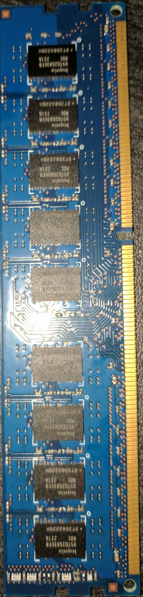
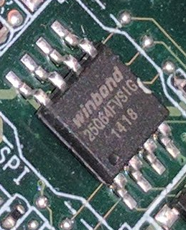
CPU 0 Haswell EP –EP (Socket R3)
CPU 1 Haswell EP –EP (Socket R3)
DDR4 channel E
RDIMM / LRDIMM
1600/1866/2133 MHz
DDR4 channel A
QPI
Port 0
(9.6GT/s)
RDIMM / LRDIMM
1600/1866/2133 MHz
RDIMM / LRDIMM
1600/1866/2133 MHz
DDR4 channel B
DDR4 channel F
RDIMM / LRDIMM
1600/1866/2133 MHz
QPI
Port 1
(9.6GT/s)
RDIMM / LRDIMM
1600/1866/2133 MHz
DDR4 channel C
DDR4 channel G
RDIMM / LRDIMM
1600/1866/2133 MHz
FW
FW
DDR4 channel H
RDIMM / LRDIMM
1600/1866/2133 MHz
DDR4 channel D
RDIMM / LRDIMM
1600/1866/2133 MHz
FW
PCI Express x8
PCIE Gen3 x8
PCIE Gen3 x4
Mini SAS HD
PCI Express x8
PCIE Gen3 x8
DMI Gen2 x4
4GB/S
PCIE Gen3 x4
Mini SAS HD
OCP SLOT1 X8
PCIE Gen3 x8
PCIE Gen3 x4
OCP SLOT2 X8
PCIE Gen3 x8
PCIE Gen3 x4
Mini SAS HD
Mini SAS HD
FW
PCH Wellsburg C612
SATA (6.0Gb/s)*4
FW
SATA (6.0Gb/s)*6
MINI SAS0
RJ45
Intel i350 Gb Lan
PCIE Gen2 x4
MINI S1SA
RJ45
SATA4
SATA5
FW
FW
USB2.0*3/3.0*4
USB 3.0
USB 2.0
USB 2.0
USB 3.0
USB 3.0
USB 3.0
USB 2.0
Rear
Front
NC SI Interface
LPC
FW
PCIE Gen2
DDR III
TPM / Debug Header
DDR3 Frame Buffer Memory
PWM
ASpeed AST2400 / AST1400
Smart Fan Controller
RGB
FW
FW
D-Sub Connector
UART
COM Port

Slide 4
Firmware Everywhere
GBe NIC, WiFi, Bluetooth, WiGig
Baseband (3G, LTE) Modems
Sensor Hubs
NFC, GPS Controllers
HDD/SSD
Keyboard and Embedded Controllers
Battery Gauge
Baseboard Management Controllers (BMC)
Graphics/Video
USB Thumb Drives, keyboards/mice
Chargers, adapters
TPM, security coprocessors
Routers, network appliances
Main system firmware (BIOS, UEFI firmware, coreboot)

Slide 5
In-the-wild Firmware Attacks
Legacy Bootkits (TDL4, Gapz…)
Mebromi BIOS rootkit
Stuxnet
EQUATION Group HDD firmware malware
] Hacking Team [ UEFI rootkit
Petya MBR Ransomware
Legitimate BIOS “backdoors”: Superfish, Computrace

Slide 6
Why Attack Firmware?
Extreme persistence
Stealth
Bypass software (OS or VMM) based security
Unfettered access to hardware
OS independence
Making the system unbootable (bricking)

Slide 7
Extreme Persistence
System firmware rootkit (in SMM or BIOS/UEFI)
Replaces OS boot loader every boot
Which patches OS kernel
Firmware rootkit is protected by the hardware write protections
Only way to fully remove the infection is to physically re-flash the flash “ROM” chip

Slide 8
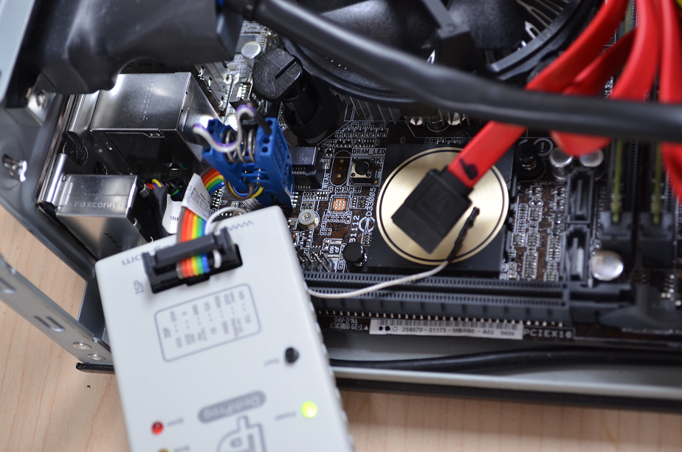

Slide 9
Stealth
Security software usually doesn’t monitor all firmware on the platform
How can software reliably tell infected from good firmware
Devices use obscure hardware interfaces to their firmware
Which tool do we use to find BIOS/UEFI infection? And rootkit in firmware of SSD, NIC, EC, BMC, modem, USB thumb-drive, battery gauge, charger?

Slide 10
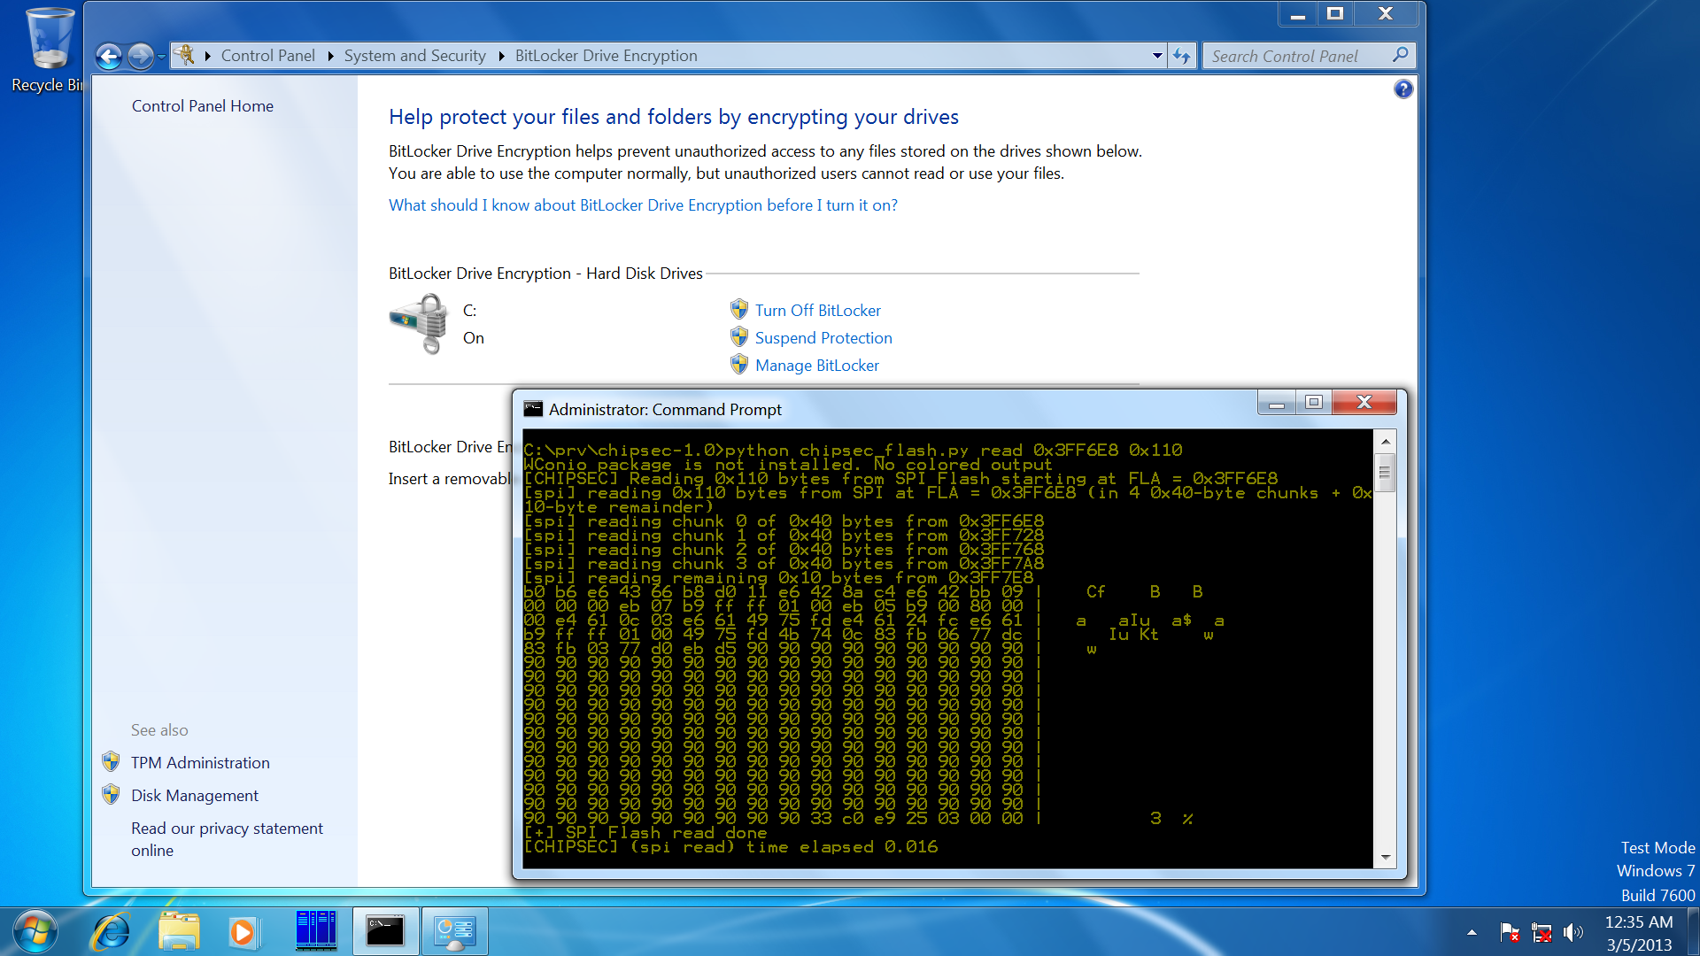
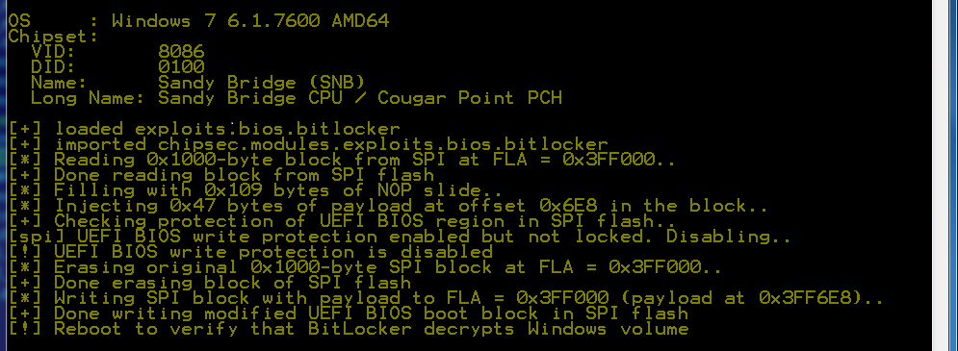
Bypass Software Security – FDE
Source: Evil Maid Just Got Angrier: Why Full-Disk Encryption with TPM is not Secure on Many Systems

Slide 11
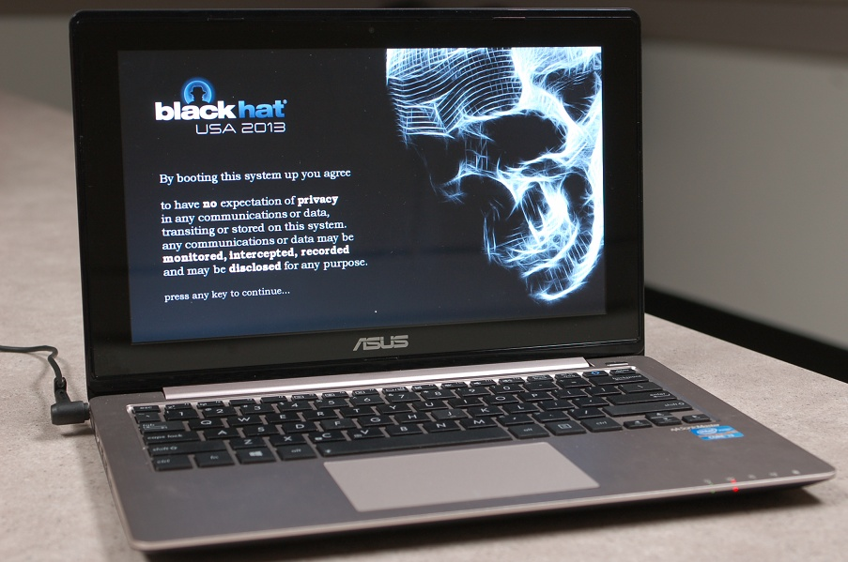
Bypass Software Security – Secure Boot
Source: A Tale of One Software Bypass of Windows 8 Secure Boot

Slide 12
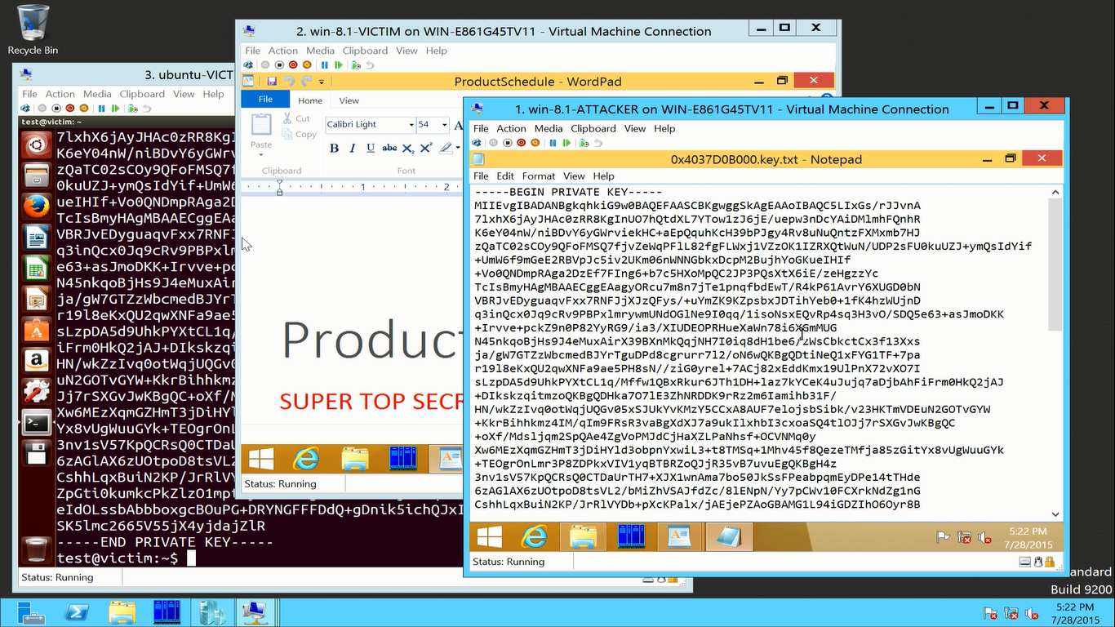
Bypass Software Security - VMM
Source: Attacking Hypervisors via Firmware and Hardware

Slide 13
Unfettered Access to Hardware - DRAM
CPU Skt
DRAM
DDR4 channel A
DDR4 channel B
SW
PCI Express
PCIE Gen3
PCI Express
PCIE Gen3
DMI
PCH
Gbe NIC
PCIE Gen2
Attacks compromising firmware on peripheral I/O devices can use inbound direct memory access (DMA) to expose sensitive contents in DRAM or modify software directly in DRAM
Reference: I/O Attacks in Intel-PC Architecture and Countermeasures by F. Lone Sang et al

Slide 14
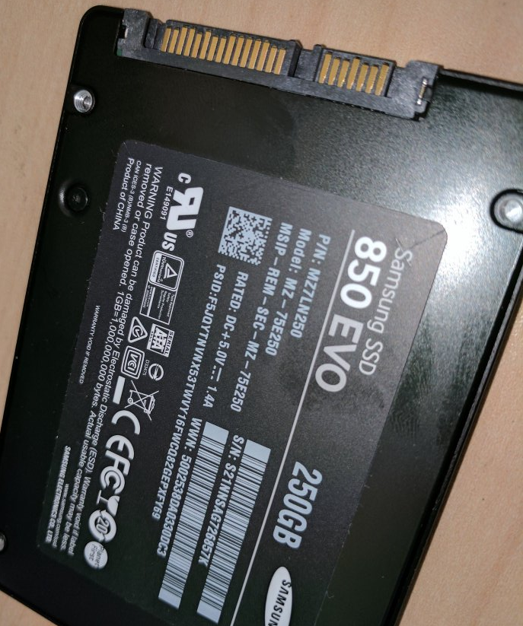
Unfettered Access to Hardware – HDD/SSD
Access to all data stored on HDD/SDD
Even when data is stored on self-encrypting drives (SED)
Example: Equation Group HDD firmware malware
Destroying your hard driver is the only way to stop this super-advanced malware

Slide 15
Unfettered Access to Hardware
NIC, WiFi, baseband modem firmware rootkits have direct access to network communications
EC or BMC firmware rootkit has access to platform management functions (power, thermal, NIC, keystrokes)
…

Slide 16
Making System Unbootable (Bricking)
Corrupt firmware or
Corrupt critical configuration
Stored in flash “ROM” memory
Of a device which is critical for system to boot or operate

Slide 17
References

Slide 18
UEFI/BIOS Security
Security Issues Related to Pentium System Management Mode (CSW 2006)
Implementing and Detecting an ACPI BIOS Rootkit (BlackHat EU 2006)
Implementing and Detecting a PCI Rootkit (BlackHat DC 2007)
Programmed I/O accesses: a threat to Virtual Machine Monitors? (PacSec 2007)
Hacking the Extensible Firmware Interface (BlackHat USA 2007)
BIOS Boot Hijacking And VMWare Vulnerabilities Digging (PoC 2007)
Bypassing pre-boot authentication passwords (DEF CON 16)
Using SMM for "Other Purposes“ (Phrack65)
Persistent BIOS Infection (Phrack66)
A New Breed of Malware: The SMM Rootkit (BlackHat USA 2008)
Preventing & Detecting Xen Hypervisor Subversions (BlackHat USA 2008)
A Real SMM Rootkit: Reversing and Hooking BIOS SMI Handlers (Phrack66)
Attacking Intel BIOS (BlackHat USA 2009)
Getting Into the SMRAM: SMM Reloaded (CSW 2009, CSW 2009)
Attacking SMM Memory via Intel Cache Poisoning (ITL 2009)
BIOS SMM Privilege Escalation Vulnerabilities (bugtraq 2009)
System Management Mode Design and Security Issues (IT Defense 2010)
Analysis of building blocks and attack vectors associated with UEFI (SANS Institute)
(U)EFI Bootkits (BlackHat USA 2012 @snare, SaferBytes 2012 Andrea Allievi, HITB 2013)
Evil Maid Just Got Angrier (CSW 2013)
A Tale of One Software Bypass of Windows 8 Secure Boot (BlackHat USA 2013)
BIOS Chronomancy (NoSuchCon 2013, BlackHat USA 2013, Hack.lu 2013)
Defeating Signed BIOS Enforcement (PacSec 2013, Ekoparty 2013)
UEFI and PCI BootKit (PacSec 2013)
Meet ‘badBIOS’ the mysterious Mac and PC malware that jumps airgaps (#badBios)
All Your Boot Are Belong To Us (CanSecWest 2014 Intel and MITRE)
Setup for Failure: Defeating Secure Boot (Syscan 2014)
Setup for Failure: More Ways to Defeat Secure Boot (HITB 2014)
Analytics, and Scalability, and UEFI Exploitation (INFILTRATE 2014)
PC Firmware Attacks, Copernicus and You (AusCERT 2014)
Thunderstrike (https://trmm.net/Thunderstrike)
Extreme Privilege Escalation (BlackHat USA 2014)
Attacks on UEFI Security (31C3)
A new class of vulnerabilities in SMI Handlers (CanSecWest 2015)
Attacking and Defending BIOS in 2015 (RECon 2015)
Exploiting UEFI boot script table vulnerability (My aimful life)
Technical details of the S3 resume boot script vulnerability (ATR)
How you Mac firmware security is completely broken (reverse.put.as)
Building reliable SMM backdoor for UEFI based systems (My aimful life)
Breaking UEFI security with software DMA attacks (My aimful life)
Attacking Hypervisors Using Firmware and Hardware (Black Hat USA 2015)
Exploiting SMM Callout Vulnerabilities in Lenovo firmware (My aimful life)

Slide 19
Other Firmware Security
CPU/SoC
ITL papers (website)
AMD x86 SMU firmware analysis (https://events.ccc.de/congress/2014/Fahrplan/system/attachments/2503/original/ccc-final.pdf) by Rudolf Marek
The Memory Sinkhole (https://www.blackhat.com/docs/us-15/materials/us-15-Domas-The-Memory-Sinkhole-Unleashing-An-x86-Design-Flaw-Allowing-Universal-Privilege-Escalation.pdf) by Christopher Domas
Full TrustZone Exploit for MSM8974 (http://bits-please.blogspot.com/2015/08/full-trustzone-exploit-for-msm8974.html?m=1)
QSEE privilege escalation vulnerability CVE-2015-6639 (http://bits-please.blogspot.com/2016/05/qsee-privilege-escalation-vulnerability.html?m=1)
USB
Turning USB Peripheral to BadUSB (https://srlabs.de/badusb/)
Practical BadUSB attack software (https://github.com/adamcaudill/Psychson)
DRAM
Cold Boot attacks (https://citp.princeton.edu/research/memory/)
Exploiting the DRAM rowhammer bug (http://googleprojectzero.blogspot.com/2015/03/exploiting-dram-rowhammer-bug-to-gain.html?m=1)
Battery
Battery Firmware Hacking (https://reverse.put.as/wp-content/uploads/2011/06/Battery-Firmware-Hacking.pdf) by Charlie Miller
NIC
NIC SSH Rootkit (http://cryptome.org/2014/02/nic-ssh-rootkit.htm) by Arrigo Triulzi
Project Maux Mk.II (http://www.alchemistowl.org/arrigo/Papers/Arrigo-Triulzi-PACSEC08-Project-Maux-II.pdf) by Arrigo Triulzi
Management Controllers
IPMI: Freight Train to Hell (http://fish2.com/ipmi/bp.pdf) by Dan Farmer
Sticky finger and KBC custom shop (http://esec-lab.sogeti.com/static/publications/11-recon-stickyfingers_slides.pdf) by Alexandre Gazet
Illuminating the security issues surrounding Lights-Out server management (https://jhalderm.com/pub/papers/ipmi-woot13.pdf)

Slide 20
Training materials are available on Github
https://github.com/advanced-threat-research/firmware-security-training
Yuriy Bulygin @c7zero
Alex Bazhaniuk @ABazhaniuk
Andrew Furtak @a_furtak
John Loucaides @JohnLoucaides

